Slide 1
LLAMA 3.1 PAPER
EXPLANATION
Training Pipeline, Dataset Collection, Processing, Infrastructure and many more…

Slide 2
OVERVIEW
Mostly the same architecture as Llama 3 and predecessors
For stable training, MOE is avoided
Followed a Multi-Stage Training Process: Multi-Stage Pretraining, Post-Training, SFT, Rejection Sampling, DPO
Multimodal Adapters under development

Slide 3
MODEL ARCHITECTURE

Slide 4
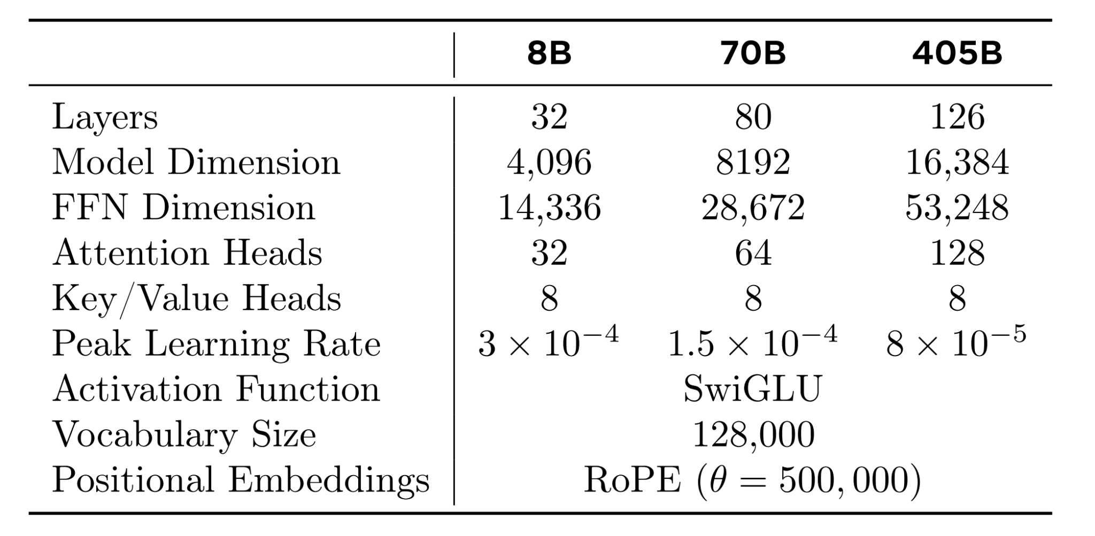
ARCHITECTURE INFORMATION
Attention - Grouped Query Attention with 8KV heads
Vocab Size - 128k -> (100k - tiktoken encoder, 28k - additional tokens for non English langs)
Attention Mask - Prevent Self Attention between documents within same sequence. Very crucial in long context training

Slide 5
PRETRAINING

Slide 6
DATA COLLECTION & PROCESSING
Custom HTML Parser - Crawl web data and maintain structure for math and code
Deduplication - URL, Document and Line level
N-Gram Ratio - Removes Redundant content
Token Distribution KL Divergence - Filter Documents with High Outliers
FastText - 176 language documents classification
Data Ratio - 50% GK, 25% Math and Reasoning, 17% Code and 8% Multilingual

Slide 7
TRAINING RECIPE

Slide 8
TRAINING PROCEDURE
Largest model 405B parameters is trained on 15.6T tokens
Initially trained on 8k context length data
Gradually context length increased in 6 stages to 128k
Initial Setup - Batch Size 4M tokens, 4096 seq len
Doubled to 8M and 8192 after 252M tokens trained
Again doubled to 16M after 2.87T tokens
For long conext pretraining, 800B tokens were trained at the final stage of pretraining. This is very stable

Slide 9
POST (PRE) TRAINING

Slide 10
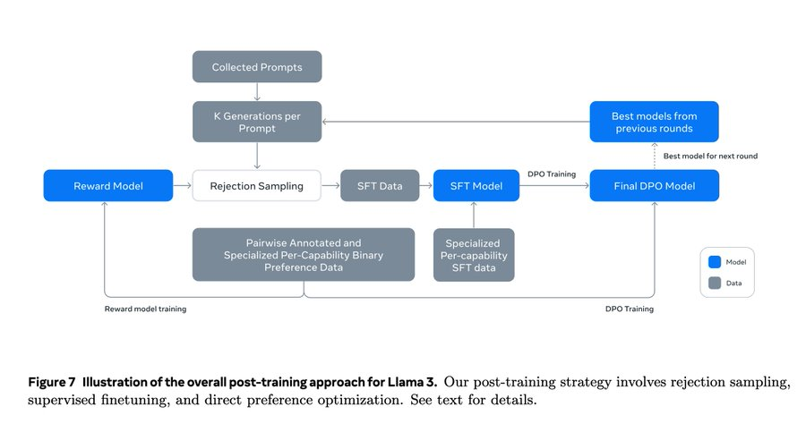

Slide 11
POST PRE-TRAINING PROCEDURE
SFT Training followed by DPO on Preference Data
For data a mix of human annotated and synthetic(AI generated) data is used
Before the process of SFT and DPO train a reward model on human annotated preference data
Special Headers and Termination Tokens are used for new capabilities like tool use with a multi-message chat protocol

Slide 12
REWARD MODELING

Slide 13
REWARD MODELING PROCEDURE
In reward modeling, we keep the training goal the same but remove the margin term in the loss function
The reward model is used for rejection sampling on human-annotated prompts where 10-30 outputs are chosen.
Each preference ranking sample has two or three responses with rankings as: edited > chosen > rejected
Edited indicates that the sample is edited in the iterations of training

Slide 14
SUPERVISED FINETUNING

Slide 15
SFT PROCEDURE
SFT training of model is on rejection-sampled data combined with real data and synthetic data
Trained with a lr of 1e-5
Trained for 8.5K to 9K steps
Important: Prompt tokens are masked for efficient loss calculation only for the tokens generated by LLM. Example: A formatted prompt for QA with Answer tag to complete. Loss calc only for those tokens

Slide 16
DPO TRAINING

Slide 17
DPO TRAINING PROCEDURE
Trained on preference data collected using the best-performing models from previous alignment rounds (lr=1e-5, β=0.1).
Special header and termination tokens are masked to stabilize training.
Masking these tokens prevents conflicting learning objectives.
NLL loss term with a 0.2 scaling coefficient is applied to the chosen
sequence.

Slide 18
VISION MODEL

Slide 19
DATA COLLECTION AND PROCESSING
Image-Text and Video-Text pairs data are used for training the image encoder
Annealing dataset created by resampling the image-caption pairs to 350M examples using n-grams.
Additional 150M examples collected using visual grounding, screenshot parsing, question-answer pair, synthetic captions, synthetically generated images from charts, tables, equations, etc represented via LaTex or markdown

Slide 20
MODEL ARCHITECTURE
Consists of three components - Image Encoder, Image and Video Adapter
Image Encoder: ViT/H-14 variant, 630M params, trained on 2.5B image-text pairs, five epochs. Image size - 224x224 Patch size - 16. Multi-layer feature extraction from previous layers and injected into final layer to preserve fine-grained localization information. 40 transformer blocks with 8 gated attn layers
Image Adapter: Grouped Query Attention with the cross attention layer accounting to 100B params approx. Trained in two stages
Video Adapter: 64 frames uniformly sampled from a video each processed by image encoder. Temporal information using temporal aggregator (perceiver resampler), and some additional cross-attention layers

Slide 21
PRETRAINING
For image, started with pre-trained text model and vision encoder weights.
Vision encoder is unfrozen, text frozen, and trained using 6B image-text pairs with a batch size of 16,384, cosine schedule, lr 10e-4 with weight decay of 0.01
For video, start from the image pre-trained and annealed weights. Video aggregator trained from scratch while everything else is froze

Slide 22
POST TRAINING
- Data procedures are mostly the same as in the case of text
- Academic datasets, human-annotated and synthetic data
- For quality tuning, a small but highly selective with utmost quality data is curated.
DPO is done on this data to improve response quality to help improve human evaluations

Slide 23
SPEECH MODEL

Slide 24
DATA COLLECTION AND PROCESSING
15M hours of multilingual speech data for pretraining
ASR training data contains 230K hours of manually transcribed
Speech recordings spans for 34 languages.
AST training data contains 90K hours of translations in two directions (33 languages -> English and English ->33 language)
25K hours of synthetic data

Slide 25
MODEL ARCHITECTURE
Speech encoder and speech adapter.
Speech encoder is a Conformer model with 1B parameters.
Input is an 80-dimensional mel-spectrogram processed by 4-stride stacking layers and a linear projection before the Conformer encoder.
Each Conformer layer has a 1536 latent dimension, two 4096-dimension Macron-net style feed-forward networks, a convolution module with kernel size 7, and a rotary attention module.
The speech adapter has about 100M parameters, composed of a convolution layer, a rotary Transformer layer, and a linear layer.

Slide 26
TRAINING
Pre-training uses unlabeled data and the BEST-RQ algorithm for the speech encoder.
A 32-frame mask (2.5% probability) is applied to the input mel-spectrogram.
Features are quantized by stacking 4 frames, projecting to a 16-dimensional space, and performing a NN search within a codebook of 8,192 vectors.
Multi-softmax loss is used only on masked frames.
Encoder trained for 500K steps with a batch size of 2,048 utterances.
SFT integrates the adapter and pre-trained encoder with the language model, keeping the LLM frozen.

Slide 27
CONCLUSION

